Slide 1


Slide 2


Cart Shopping System
Second Year Project Synopsis
Submitted by:
ROLL NO. | NAME
2301730083 | Samya Sharma
2301730084 | Namrata
2301730115 | Anushka Rana
2301730122 | Dhruv Tyagi
Industry Mentor: Mr. Prem Kumar Thakur
Faculty Mentor: Dr. Vandna Batra
Notes:
New Courses replaced with New Programmes

Slide 3

Project Overview
Cart Shopping System is an e-commerce application designed specifically for wholesale ration shops to tackle issues like overcrowding, inefficient billing, and long queues. It offers a streamlined, digital shopping experience that enhances convenience for customers and improves operational efficiency for shop owners.
Key Features:
Digital Product Catalog: Customers can browse and select items from an organized online catalog.
Seamless Cart & Checkout: A user-friendly interface allows easy order placement through on-site screens.
Multiple Payment Options: Supports secure digital payments, reducing cash handling and billing time.
This system not only minimizes wait times but also ensures a smooth and efficient shopping experience. By digitizing the shopping process, Cart Shopping System provides a scalable, customer-friendly, and future-ready solution for modernizing wholesale ration stores.
Notes:
New Courses replaced with New Programmes

Slide 4
Problem Statement
The Problem:
Traditional manual billing and order systems in wholesale ration shops lead to overcrowding, long queues, billing errors, and customer dissatisfaction. These outdated methods also create operational inefficiencies and security risks.
The Solution:
A digital e-commerce platform tailored for wholesale ration shops that simplifies the shopping experience and optimizes backend operations.
Security: Only verified users can access and complete orders.
Efficiency: Real-time, automated billing and order processing reduce wait times.
Accountability: Every transaction is logged digitally for transparency.
Cost & Time Savings: Minimizes paperwork and speeds up customer service.
Notes:
New Courses replaced with New Programmes

Slide 5
Goals:
Main Goal: Develop a secure, automated cart-based system for ration shopping.
Real-Time Order Placement & Approvals
Secure Payment Gateway Integration
Automated Order Forwarding to Staff
Reduced Manual Workload & Queues
Impact:
Enhanced Customer Convenience through digital browsing and instant checkout
Improved Store Efficiency with automated backend systems
Better Inventory & Order Tracking using digital records
Optimized Workload for Staff by eliminating manual order handling

Slide 6
Technology used
Here’s a list of technologies used in the project based on the folder structure and file names:
Frontend : Backend :
HTML Node.js
CSS Database Management
Javascript
For Payment :
Razorpay
qrcode.react
We have used these technologies so far, and we will incorporate additional ones as needed.
Notes:
New Courses replaced with New Programmes

Slide 7
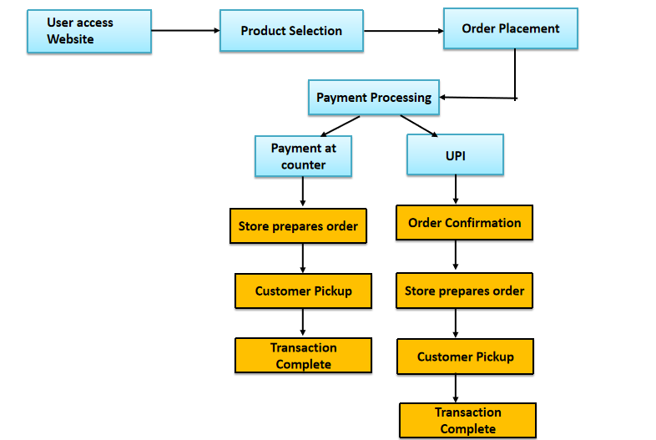
System Workflow Diagram
Notes:
New Courses replaced with New Programmes

Slide 8
Future Aspects
Online Payment Gateway Integration
Incorporate secure and reliable payment gateways to facilitate seamless digital transactions, supporting credit/debit cards, UPI, and digital wallets.
Real-Time Inventory Management
Implement live stock tracking to ensure accurate availability information, prevent over-selling, and enable timely restocking.
Customer Profiles & Personalization
Introduce customer accounts with purchase history, preferences, and personalized recommendations to enhance user engagement and loyalty.
Mobile App Version
Develop a cross-platform mobile application to allow customers to shop conveniently anytime, anywhere, improving overall accessibility.
Multi-Store Support
Enable centralized management of multiple stores within a shopping complex or retail chain, offering scalability and flexibility for diverse business needs.
Notes:
New Courses replaced with New Programmes

Slide 9
THANK YOU

